Slide 1
Users and Groups
27 November 2013
Notes:
Guidewire training materials contain Guidewire proprietary information that is subject to confidentiality and non-disclosure agreements. You agree to use the information in this manual solely for the purpose of training to implement Guidewire software solutions. You also agree not to disclose the information in this manual to third parties or copy this manual without prior written consent from Guidewire. Guidewire training may be given only by Guidewire employees or certified Guidewire partners under the appropriate agreement with Guidewire.

Slide 2
Lesson objectives
By the end of this lesson, you should be able to:
Manually create and modify users
Manually create and modify groups
Import user and group data from files
This lesson uses the notes section for additional explanation and information. To view the notes in PowerPoint, choose View→Normal or View→Notes Page. If you choose to print the notes for the lesson, be sure to select “Print hidden slides.”

Slide 3
Lesson outline
Users
Groups
Importing user and group data

Slide 4
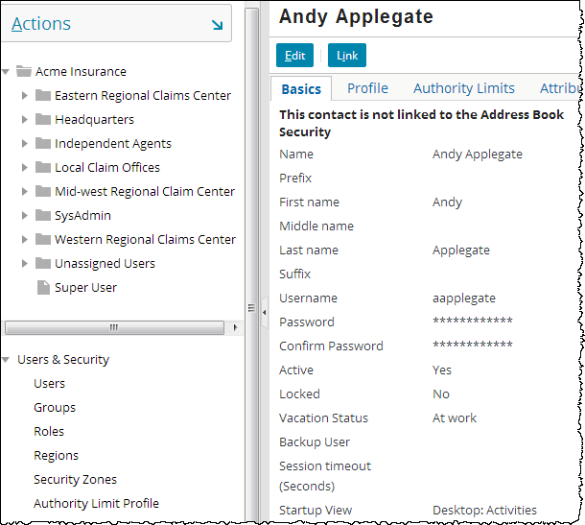
User management
Managed through ClaimCenter Administration tab
Virtually every user attribute pertains to what a user owns (assignment) and/or what a user can access (permissions)
Notes:
Authority limits define financial approval authority when creating reserves and payments. They are discussed in greater detail in the “Transaction Approval Rules” lesson.
For more information on how users are authenticated and managed using external user administration systems such as LDAP or Active Directory, refer to the “Authentication Integration” lesson in the Guidewire 8.0 Integration Fundamentals training course.

Slide 5
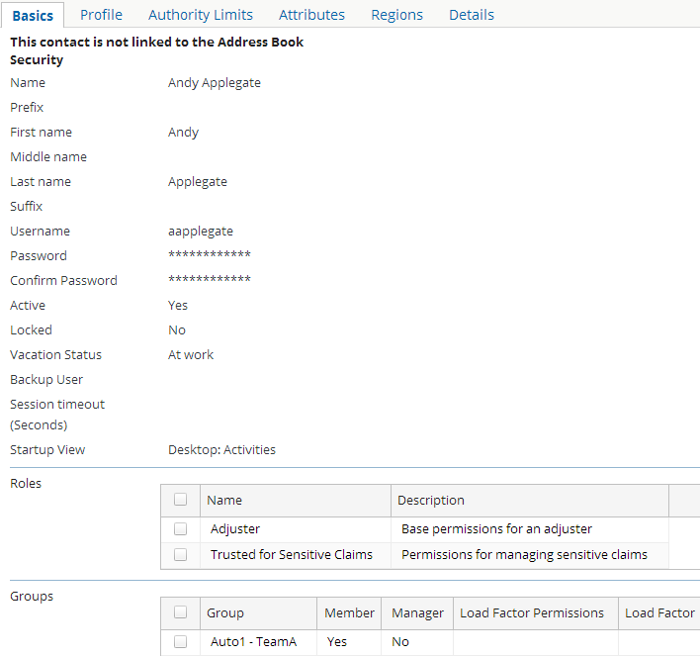
User details - basics
Credentials
Statuses (active, locked, vacation)
Roles (sets of permissions)
Group membership
Notes:
The Basics card lists information about the user with regards to:
Credentials (such as user name and password)
Statuses (is the user active, is the user account locked, and is the user reporting for work regularly or on vacation)
Roles (Recall that a role is a set of permissions assigned to a user to grant the ability to view and edit data in ClaimCenter)
Group membership (which group(s) does the user belong to)

Slide 6
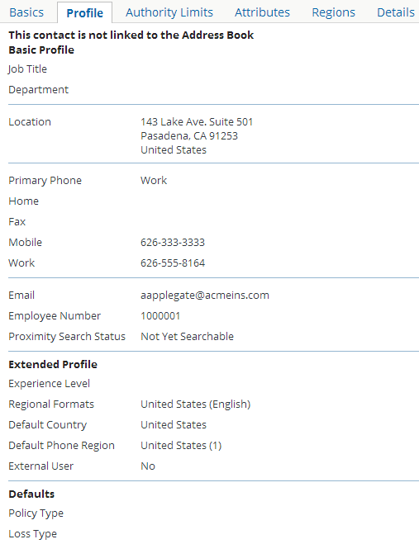
User details - profile
Basic Profile
Employee data
Contact information
Extended Profile
Experience level
Language
External user
Application defaults
Policy type
Loss type
Notes:
Extended Profile attributes:
Experience Level - Identifies user's level of experience. This can be used by rules to determine the level of detail a claim's workplan should have when assigned to a given user. (For example, a "Verify coverage" activity might be generated for a user with low experience whereas it wouldn't for a user with mid or high experience.) It could also be used to determine if a user is experienced enough to handle a given type of claim.
Regional Formats, Default Country, Phone Region – Regional Format identifies the user's locale (such as “Great Britain (English)” or “Japan (Japanese)”). A user's locale determines which set of labels are used when that user logs on to ClaimCenter, as well as date and number formats. Country and Phone Region set other labels and formats, such as the telephone country code (such as 33 (France)).
External user - Identifies whether a user is internal (a human being who will log in and interact with the ClaimCenter user interface) or external (such as a third-party application to whom work is assigned but who processes the work outside of ClaimCenter).
Defaults attributes:
Policy Type - The default value for policy type when this user creates a new claim in the NCW.
Loss Type - If the loss type is set to a type with multiple quick claim wizards (such as Auto, which has "Quick Claim Auto" and "Auto First and Final"), then this field appears and determines the default quick wizard for the given user.

Slide 7
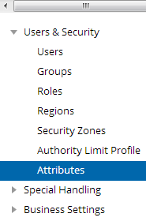
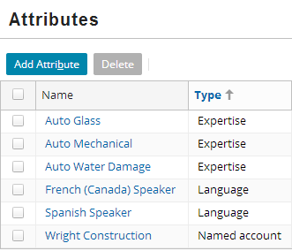
Custom user attributes
Attributes defined through ClaimCenter which can be associated to users
Typically used by assignment rules
Notes:
Custom user attributes provide administrators with a mechanism for creating new attributes that can be assigned to users without needing to modify the data model.
Each custom user attribute has a name, a type, and a description. In the base application, the possible types are Default, Expertise, Language, and Named account (to be granted to users who have experience with a given account).
All attributes must first be added in the screen shown above before they can be assigned to users.

Slide 8
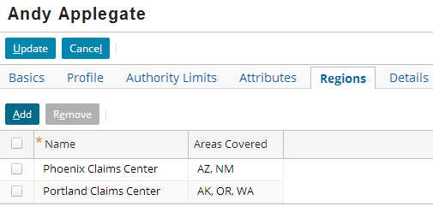
User details - regions
User can have zero to many regions
Typically used by assignment rules
Notes:
In the example above, Andy Applegate is assigned to both the Phoenix Claims Center region and Portland Claims Center region. If a claim needs to be assigned to a user in Arizona (which is included in the Phoenix ClaimCenter region), then it potentially could go to Andy Applegate. If a claim needs to be assigned to a user in New York, then it could not go to Andy Applegate as he has not been assigned to any region including this state.

Slide 9
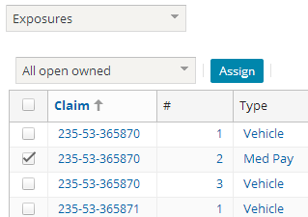
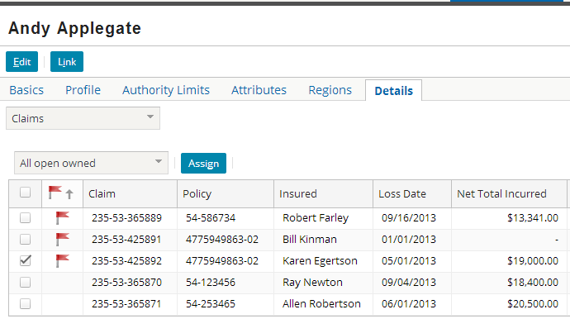
User details - owned objects
Similar to the Team tab, the Details card lets an administrator view and act on all objects (activities, claims, exposures, matters) owned by a given user
Objects owned by a user can be reassigned or viewed

Slide 10
Lesson outline
Users
Groups
Importing user and group data

Slide 11
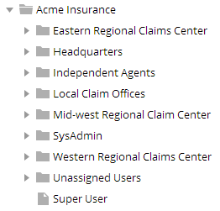
Review: Groups
Andy Applegate
Betty Baker
Auto1 TeamA
Sue Smith (supervisor)
Recall that a group is a collection of users who complete similar tasks
Some functionality is tied to ClaimCenter groups
When planning group hierarchy, this functionality should be kept in mind
Notes:
In a live instance of ClaimCenter, the majority of the groups reflect the reporting structure of the carrier. (In other words, for most groups, the individuals of the group are all assigned to the same department and all report to the same supervisor.) There are a small number of groups which do not reflect reporting structure, but instead reflect a common job responsibility shared by two or more individuals in different departments. These groups are sometimes referred to as "virtual" groups because they do not represent any aspect of the reporting structure. Virtual groups are created to simplify the assignment of objects which involve similar logic but individuals in different parts of the organization's hierarchy.
Ultimately, the ClaimCenter group hierarchy should be defined to support:
Assignment logic (for both automatic and manually assigned objects)
Access (so that users who should have shared visibility into a claim can be easily given that access)
Supervisor and manager functionality (for visibility into objects owned by other users and for escalation)
Reporting

Slide 12
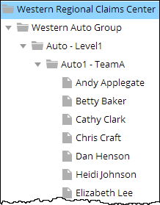
Functionality that may make use of groups
Assignment
Round robin and load factors
Activity queues
"Pending assignment" claims
Access
Access control lists
Manager and supervisor functionality
Team tab
Upline access
Flagged and suspicious claims (SIU)
Activity escalation
Transaction approval
Reporting
Notes:
Assignment
Once an object is assigned to a group, it can be round-robin assigned to members of the group. (User A gets the first object, user B gets the second object, and so on.) This can also be based on load factors, which let you designate that objects should not be distributed equally but rather in some proportion. (Note: It is also possible to do round-robin assignment with users who do not belong to a single group [in which case load factors are ignored.] Round-robin assignment with or without load factors is arguably easier to implement with groups, but it is not limited to groups.)
Activity queues are collections of activities that have been assigned to a group but not to any user in that group. Each queue is associated to one specific group, and usually all members of the group can view and take ownership of activities in the queue.
Once assigned to a group, instead of being assigned to a user, an object can be marked "pending assignment". In this case, the group supervisor manually assigns the claim to someone in the group.
Access
Access control lists are used to identify who should have view and/or edit access to a claim. Access control list logic can be based on group membership. For example, you could specify that the people with view and edit access into a given type is claim is anyone in the group that owns the claim. This lets any user see or work on the claim, even if he or she is not the user who owns the claim.
(continued)

Slide 13
(Notes only slide)
Notes:
Manager and Supervisor Functionality
The Team tab lets a manager or supervisor view and edit any object owned by any person in his or her group.
Upline access lets any manager or supervisor view or edit an object as if he or she were any given downline user. For example, if Andy Applegate is in a group supervised by Sue Smith, then Sue Smith can view and edit any object that Andy Applegate could view or edit.
When a claim is flagged, it is common business practice for an activity to be generated and sent to the supervisor of the group which owns the claim. The supervisor then addresses the issue. Similarly, if a claim crosses the Special Investigation Unit (SIU) threshold, then an activity is generated and sent to the supervisor of the group which owns the claim so that the supervisor can determine if the SIU team should review the claim.
When an activity remains open beyond its escalation date, it is common business practice for an activity to be generated and sent to the supervisor of the group which owns the claim.
When a transaction requires approval (either because of a specific business condition or because of an authority limit), an activity is created and routed to the supervisor of the group which owns the transaction's claim.
Reporting
Reporting data is commonly aggregated at the group level.

Slide 14
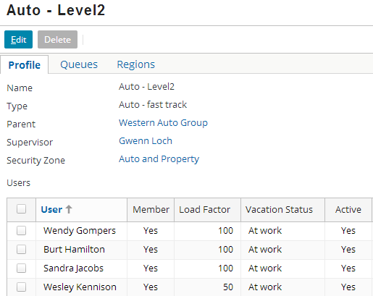
Group attributes
Name must be unique
Type is typekey to GroupType typelist
Except for a single root group, every group must have exactly one parent
Every group must have exactly one supervisor
Notes:
To change a group's location in the hierarchy, change the group parent. When a group is moved, all its child groups are moved with it.
The supervisor may or may not be a member of the group. A supervisor who is a member of the group may get work assigned to him or her as a member, whereas a supervisor who is not a member typically would not.
A security zone is a collection of groups which have access to the same claims. Security zones are used to configure access control lists. (Security zones are created through the Security Zone administration screen. Groups are then assigned to security zones at the group level.)
At the group's User level, load factors are used by automated assignment to distribute work among the members of the group. New or part-time people can have fewer assignments than a more experienced person. The load factor represents the percentage of a full share of the load. Typically, 100 is used to represent a full share, and numbers less than 100 represent a portion of a full share (such as 50, which would mean half as much as someone with a full load).
Round robin assignment can also be done at the group level. For example, an object assigned to a parent group could be round robined among its child groups. In this case, the group's load factor comes into play, determining how much of a full load is assigned to a given child group.

Slide 15
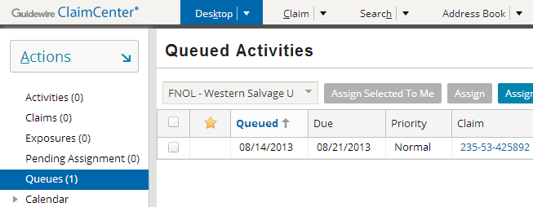
"Activity" queues
Every queue is associated to a group
Queues contain activities assigned to the group but not to any user in that group
Notes:
A queue is an ordered list associated to a group which contains activities that have been assigned to the group but not yet assigned to any user within that group. Users within the group can take ownership of activities in the queue. Unlike groups and users, which can own any type of assignable object, queues can contain only activities.
Users can view objects assigned to queues they have access to by clicking the Queues page link on the Desktop tab. The queues the user has access to are listed in the dropdown at the top of the list. Once the user selects a given queue, all objects in the queue appear in the list. The user can then take ownership of a given queue by clicking the "Assign Next In Queue To Me" button. Some users may have permission to take ownership of any item (not just the next item in the queue).

Slide 16
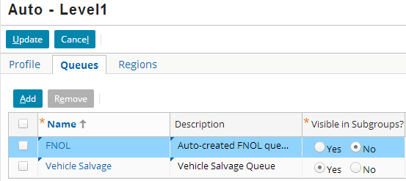
Configuring queues
Every group automatically has an FNOL queue
Additional queues can be added
Queues can be visible to child groups
Notes:
To define a new queue:
Click Edit on the Queues tab.
Click Add.
Provide a unique name and description.

Slide 17
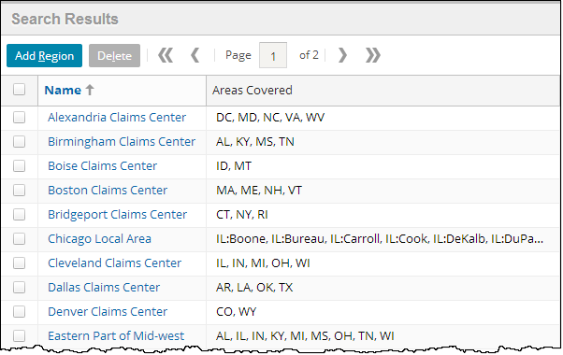
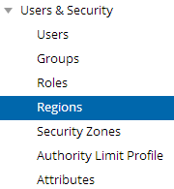
Regions
Geographic area that group covers
Can be defined by (US) counties, states, zip codes, and so on
Not inherited by child groups
Each Region is tied to a single country
Typically used by assignment rules
Notes:
Regions are managed on the Administration tab. You should define the regions early in the implementation. You can then use each region across multiple groups. You can also change the definition of a region to redefine the area it covers (which will impact any group (or user) to which that region is assigned).
To define a new region:
Click the Regions page action.
Click Add Region.
Give your region a unique name and select its type (County, State, or Zip code).
Add counties, states, or zip codes to your region definition, and then save it.
Now you can use the region for this or other groups.

Slide 18
Lesson outline
Users
Groups
Importing user and group data

Slide 19



Review: Data imported from files
Data typically imported prior to application launch
Permissions, roles, and authority limits
Users, groups, and security zones
Activity patterns
Script parameters
Data can also be periodically exported and imported
For example, when security zones are reconfigured
import tools
Notes:
The data typically imported before an instance of ClaimCenter is put into production includes:
Data to manage access, including:
Permissions - the individual abilities a given user can have to view or edit data
Roles - the set of permissions granted to a user with a given job responsibility
Authority limits - the types of financial transactions a user can create which do not require additional approval
Data to manage users, including:
Users
Groups
Security zones - the sets of groups which are treated as a single unit for the purpose of managing access to claims
Data to manage activities
Activity patterns - the types of activities that ClaimCenter uses when generating workplans or when giving a user a list of activities to select from when adding work to a claim
Data for business rules
Script parameters - values (which are typically numeric) used in business logic (such as the number of days a claim can be open before it gets flagged)

Slide 20
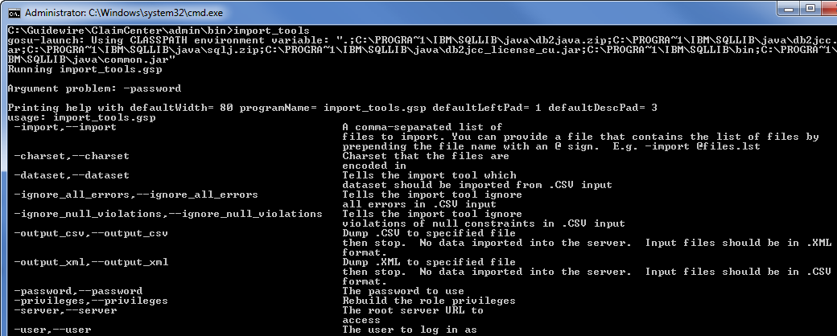
File import via import_tools utility
Command-line utility in <installDirectory>\admin\bin
Imports one to many files in CSV or XML format
Does not check files prior to import for syntax problems or conflicts with existing data
Notes:
If you attempt to import a file with syntax errors, import_tools still attempts to import all valid rows. Imports with syntactically incorrect files can be troublesome because it is not apparent which rows were imported and which were not.
ClaimCenter uses public IDs to uniquely distinguish rows of data during the import process. For a given entity, if a given row of data in the ClaimCenter database has the same public ID as a record in an import file, the import file version will overwrite the existing row in the database. The records are not merged. (For example, if a contact exists in the database with a public ID of "testrecord:060208", a first name of "Kevin", and a last name of "Travis", and an import file has a contact with public ID "testrecord:060208" and no first or last name, then after the import, the given contact will have a blank first and last name.)

Slide 21
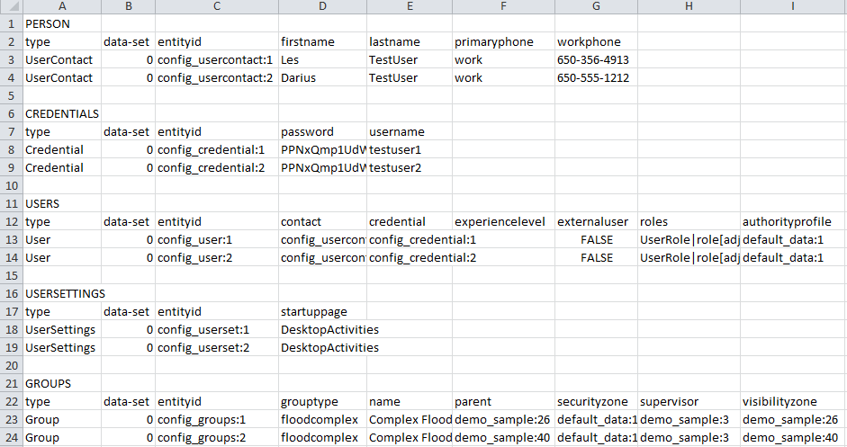
Sample CSV file
Notes:
A CSV file can contain any number of records for any number of entities.
For each entity, the entity name must appear on a line by itself. (For example, line 1 contains the name of the entity "PERSON", and nothing else.) Each entity must be followed by a list of field names. The first three fields must be "type", "data-set", and "entityid", in that order. The remaining fields can be fields from the entity in any order. The file does not need to contain all fields on the entity, but all required fields must be specified.
The entitiyid values are stored inside ClaimCenter in the PublicID column for the relevant table.

Slide 22
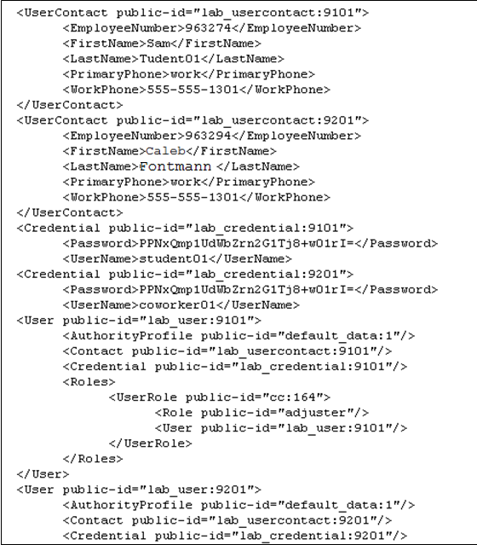
Sample XML file

Slide 23

Using import_tools
Must be executed from <installDirectory>\admin\bin
Syntax:
import_tools -import fileName -password password
Defaults to using "su" user account
fileName can reference file or file list
If fileName references files outside of admin\bin, then file must be preceded by path to its location
Additional flags exist which have not been listed above

Slide 24
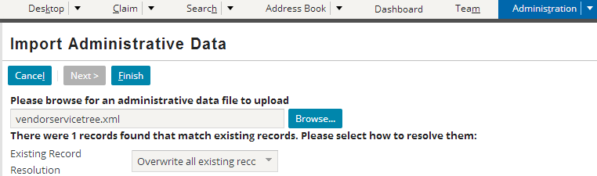
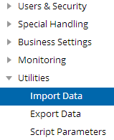
Review: File import via import admin screen
GUI tool on ClaimCenter's Administration tab
Imports one file only in XML format
Check file prior to import for syntax problems and conflicts with existing data
Notes:
If you attempt to import a file with syntax errors, the Admin screen will identify that the file has errors and will not attempt the import.
ClaimCenter uses public IDs to uniquely distinguish rows of data during the import process. For a given entity, if a given row of data in the ClaimCenter database has the same public ID as a record in an import file, the Admin screen will identify the two versions of the record and ask the end user to identify the one that should take precedence. Precedence occurs at the record level, not the field level. In other words, you must either keep the record in the database as is or import the entire new record.

Slide 25
Lesson objectives review
You should now be able to:
Manually create and modify users
Manually create and modify groups
Import user and group data from files

Slide 26
Review questions
What is a user "custom attribute"?
When you associate a custom attribute to a user, what two things can you specify in addition to simply saying the user has the custom attribute?
For each item listed below, provide one example of how groups make use of or are influenced by that item:
Assignment
Access
Supervisor/manager capabilities
What kind of objects are placed in queues? Why would you assign such an object to a queue?
Notes:
Answers
1. A custom attribute is an attribute you want to be able to assign to users to assist in assignment of work. For example, you may want to assign claims involving auto glass damage to users with auto glass expertise.
2. You can specify a state and a "value" (typically an expertise level) to the attribute.
3. a) Possible answers: Round robining, activity queues, pending assignment claims
b) Access control lists
c) Possible answers: Team tab, upline access, claims that are flagged or cross the SIU threshold, activity escalation, transaction approval
4. Activities. You would assign an activity to a queue when you want each user with access to the queue to have the ability to take ownership of the activity (as opposed to having it explicitly assigned to a given user).

Slide 27
Notices
Copyright © 2001-2014 Guidewire Software, Inc. All rights reserved.
Guidewire, Guidewire Software, Guidewire ClaimCenter, Guidewire PolicyCenter, Guidewire BillingCenter, Guidewire Reinsurance Management, Guidewire ContactManager, Guidewire Vendor Data Management, Guidewire Client Data Management, Guidewire Rating Management, Guidewire InsuranceSuite, Guidewire ContactCenter, Guidewire Studio, Guidewire Product Designer, Guidewire Live, Guidewire DataHub, Guidewire InfoCenter, Guidewire Standard Reporting, Guidewire ExampleCenter, Guidewire Account Manager Portal, Guidewire Claim Portal, Guidewire Policyholder Portal, ClaimCenter, BillingCenter, PolicyCenter, InsuranceSuite, Gosu, Deliver Insurance Your Way, and the Guidewire logo are trademarks, service marks, or registered trademarks of Guidewire Software, Inc. in the United States and/or other countries.
All other trademarks are the property of their respective owners.
This material is confidential and proprietary to Guidewire and subject to the confidentiality terms in the applicable license agreement and/or separate nondisclosure agreement.
This file and the contents herein are the property of Guidewire Software, Inc. Use of this course material is restricted to students officially registered in this specific Guidewire-instructed course, or for other use expressly authorized by Guidewire. Replication or distribution of this course material in electronic, paper, or other format is prohibited without express permission from Guidewire.
Guidewire products are protected by one or more United States patents.

